Slide 1
Asking and Evaluating Relevant and Focused Research Questions
Module 4, Engaging in Inquiry

Slide 2

Starting Research off Right—Turning Topics into Questions
Module 3 led you through some exploratory research using pre-designed questions; Module 4 will now move us from thinking generally about topics to how to form questions of your own. To do this, we first take a broad topic and then let the initial research findings shape our questions as we “zero in” on the “target”:
Ask open-ended questions (think “how” and “why”)
Consider the value—“so what?” (why does this topic matter to you? To others?)
Then, prioritize a few to explore further and evaluate
What aspect of the general topic will you explore?
Is the question clear? Focused? Complex?
Hypothesize about the path you might take to an answer (which sources? Which primary kind of material? Which methods of inquiry?)

Slide 3
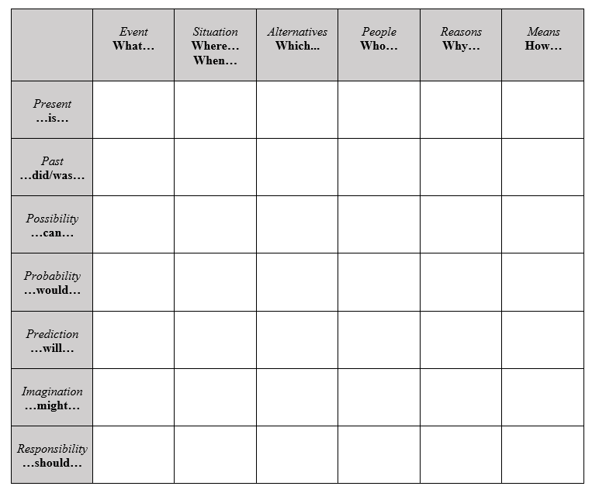
Resource--The Q-Matrix

Slide 4

Process for Question Formulation
Pick a topic, do some preliminary research
Write down as many questions as you can that relate to a topic (no questions are ‘dumb’ questions… they help lead us to others)
To improve, make sure the questions you prioritize:
are open-ended
require a judgment (argumentative)
are researchable (there is material related to the question available, and it’s credible and considerate)
involve ongoing debates
contain a variety of valuable, different perspectives (what two—or-more-sides exist on the issue?)
limited to single questions
within the proper scope of the assignment
Rank the questions based on interest, relevance, and researchability
Do a little more preliminary research to narrow the selection
Select and begin “capital R” Research

Slide 5
Some Examples
Unclear Question
Too Simple
Unfocused
Why are social networking sites harmful?
How are doctors addressing diabetes in the United States?
What is the effect of global warming on our climate?
More Clear
More Complex
More Focused
How are online users experiencing or addressing privacy issues on social media sites like Facebook and Twitter?
Based on the common traits of those who have Type II Diabetes in the US, how can these commonalities be used to effectively aid the medical community in establishing routine preventative measures?
How has glacial melting affected the mating processes of specific species of Penguins in Antarctica over the last two decades?

Slide 6

Setting a Good Question Framework
Considering Scope, Delimitation
SCOPE
DELIMITATION
Scope considers the boundaries set for the research project—including the kind of research, the theoretical focus and approach, and what considerations were made in setting limitations for what can be covered in the size and type of project. (For Task 1, the scope set by The College Board is a 1200-word report, and for Task 2, a 2000-word literature-based argument)
Delimitation is set by the research explicitly and acknowledges all areas of the research project that are purposefully excluded for the sake of narrowing focus—includes things like isolating to certain variables (to the exclusion of others), to certain time frames, to certain populations, types of participants, relevant perspectives, etc. (with the goal of making the research timely, meaningful, and actionable)

Slide 7


Narrowing and Focusing
Choosing Lenses and Perspectives
Lenses: overarching ways of knowing (filters for knowledge based on a particular epistemic approach or methods of inquiry by discipline)
Perspectives: positions taken on the topic within the lenses and studies
*Lenses are not perspectives, and perspectives are not lenses—these are often improperly conflated terms but actually signify different parts of the process and warrant distinction

Slide 8
The College Board’s Suggested Lenses
Cultural/Social Explores how daily issues impact lives, relationships, customs, beliefs, etc. | Artistic/Philosophical Explores how artworks express ideas about an issue and/or what philosophers think at a meta-level. | Ethical Explores issues at a moral level and considers things such as laws, human rights, consequences of actions, effects, etc.
Political/Historical Explores effects of an issue on government decisions, considers contextual background or causal relationship of events in relation to the issue. | Environmental/Scientific Explores contextual effects of an issue on the social and ecological environment; uses data from the biological, chemical, and physical level. | Economic Explores the financial impact of issue and role in possible solutions on both personal and communal level.

Slide 9
An Example
Cultural/Social What kinds of product designs are best for the environment while also appealing to consumer needs? | Artistic/Philosophical In what way does ‘work’ alienate us from personal identity? How is ‘work’ utilized as a tool for suppression in 1984? | Ethical What working hours are optimal for efficient output while also affording people time to develop individual mental health practices?
Political/Historical How have Capitalistic models of work played into the political division of today? | Environmental/Scientific How can AI technology be utilized today to mitigate some of the human folly in certain industrial designs? | Economic What is the economic impact of allowing workers to work from home at least some of the time?

Slide 10
A Good Template to Structure Your Research Question
Ask yourself the ‘so what?’ if answer is ‘I don’t know’ or ‘don’t care,’ scrap it for a new question/topic
Frame question in statements
“I am trying to learn about ______”
…”because I want to find out _____”
…”in order to help my reader understand _____.”

Slide 11
Narrowing and Focusing
Also, Acknowledging Stakeholders
Lenses help us focus the issue on a particular pattern of inquiry. Perspectives reflect the specific viewpoints being acknowledged on an issue. Recognizing the person(s) or group(s) with interest or concern in the topic of inquiry is to recognize the stakeholders whose voices matter on the issue. This also helps provide not only another means for focusing and narrowing a good research topic but also provides you the timeliness and relevance.

Slide 12


An Example
Topic = the rise of digital currencies
Lenses = Economic (economic implications of digital currency)
0000
Stakeholders = consumers, independent companies (think Venmo, Paypal, Zelle, etc.), banking industry
Perspectives = consumers’ ease and privacy using digital currencies; consumers’ concerns about volatility of value; banking’s concerns about competition to traditional market; banking’s attempt to draw from the innovation (integration of digital currency, acquisition of alternative payment companies, methods)

Slide 13
Guided Practice, Sample Question Evaluation
Reminder—things to consider when evaluating a question:
Does the question require a judgment or evaluation to be made?
Is it researchable? (not too broad, narrow, or lacking in feasibility)
Does it involve genuine points of ongoing debate?
Does it invite engagement with alternative perspectives?
Is it simple? (does it avoid embedded questions?)
[for teachers: may use slide while students work through Module 4.2 Practice Research Evaluation]

